Slide 1
PRODUCER’s EQUILIBRIUM

Slide 2
PRODUCER’S EQUILIBRIUM
The ultimate aim of any firm is to earn the maximum profit possible.
Producer equilibrium is the situation of PROFIT – MAXIMISATION .
At equilibrium, the firm has the maximum level of output being produced and earning the maximum profit out the same.
It is the equilibrium level of output which the producer will produce at MINIMUM COST and sell to earn MAXIMUM PROFIT.

Slide 3
INTRODUCTION
To explain producer equilibrium, both isoqaunt and isocost has to be analyzed.
Producer equlibrium can be explained graphically with the use of both the isoquant curve and isocost line.
It is attained at the point where the isocost line is tangent to the isoqaunt curve in the graph.

Slide 4
ISOQAUNT
It refers to equal quantity.
Isoqaunt line is the locus of points showing combination of factors ( ex: Labour and capital) which gives the producer the same level of output.
It reveals the combination of input, to get a quantity of output.
Slope of the graph gives the Marginal Rate of Technical Substitution (MRTS)

Slide 5
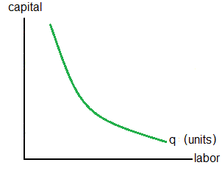
GRAPH

Slide 6
ISOCOST
It refers to equal cost.
It is the cost of purchase of two factors (capital and labour) of production in a budget.
Isocost line shows the locus of points showing the combination of inputs that can be purchased with the available budget.
The slope gives the ratio of wages ‘w’(Labour) and rate of interest ‘r’(Capital) Slope = w/r.

Slide 7
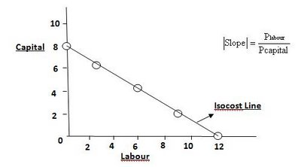
GRAPH

Slide 8
PRODUCER EQUILIBRIUM
It is attained at the point where the isocost line is tangent to the isoquant curve.
It is the point where the isoqaunt curve just touches the isocost line.
It doesn’t intersect the isocost line.
Slope of the isoqaunt curve and isocost line are the same at this point
MRTS = w/r

Slide 9
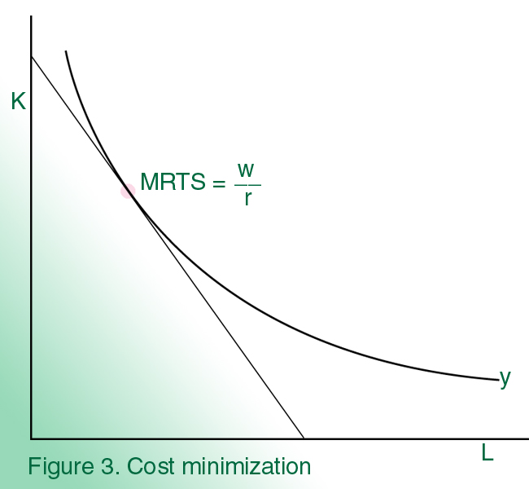
GRAPH

Slide 10
PROFIT MAXIMISATION
1) The isocost/isoqaunt Method:
Profit is maximized when the slope of isoqant is equal to slope of isocost.
2) The marginal revenue/marginal cost method
At that output, MR (the slope of the total revenue curve) and MC (the slope of the total cost curve) are equal.
These are two approaches of profit maximisation in producer equilibrium.

Slide 11
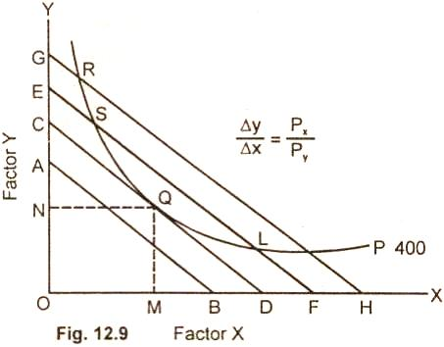
ISOCOST/ISOQAUNT

Slide 12
Cont’d….
In the graph above, CD is the isocost line that is tangent to the isoqaunt curve 400 units at point Q. The firm employs OC units of factor Y and OD units of factor X to produce 400 units of output.
In the graph any point below Q on the isocost line AB is desirable as it shows lower cost, but it is not attainable for producing 400 units of output and points R&S above Q on isocost lines GH, EF show higher cost.
These are unattainable by producer with CD budget. Hence point Q is the least cost point for producing 400 units of output with OC units of factor Y and OD units of factor X. Point Q is the equilibrium of the producer.
At this point, the slope of the isoquants equal to the slope of the isocost line.

Slide 13
MARGINAL REVENUE/MARGINAL COST
This can be obtained with the help of concept of marginal cost (MC) and marginal revenue (MR)
Marginal revenue (MR) – the change in total revenue associated with a change in quantity.
Marginal cost (MC) – the change in total cost associated with a change in quantity.
A firm maximizes profit when MC = MR and slope of MC > slope of MR

Slide 14
How to Maximize Profit
If marginal revenue does not equal marginal cost, a firm can increase profit by changing output.
The firm will continue to produce as long as marginal cost is less than marginal revenue.
The supplier will cut back on production if marginal cost is greater than marginal revenue.
Thus, the profit-maximizing condition of a competitive firm is MC = MR

Slide 15
CONCLUSION
Therefore firms produce maximum level of output with minimum cost of production and earn the maximum profit during producer equilibrium.

