Slide 1
KURT LEWIN’S CHANGE MANAGEMENT MODEL

Slide 2
WHY CHANGE??
-Business Environment is constantly changing.
-To meet the strategic needs of the business.
-Competitiveness.
-To improve efficiency and produvtivity.

Slide 3

Kurt Lewin’s Model

Slide 4
UNFREEZE
First stage of change.
Involves preparing the organization to accept that change is necessary, which involves break down the existing status quo before you can build up a new way of operating.
Most difficult and stressful.

Slide 5
MOVEMENT
People begin to resolve their uncertainty and look for new ways to do things.
People start to believe and act in ways that support the new direction.
The transition from unfreeze to change does not happen overnight: People take time to embrace the new direction and participate proactively in the change

Slide 6
MOVEMENT
Time and communication are the two keys to success for the changes to occur. People need time to understand the changes and they also need to feel highly connected to the organization throughout the transition period.

Slide 7
FREEZE
When the changes are taking shape and people have embraced the new ways of working, the organization is ready to refreeze.
As part of the freezing process, make sure that you celebrate the success of the change – this helps people to find closure, thanks them for enduring a painful time, and helps them believe that future change will be successful.

Slide 8
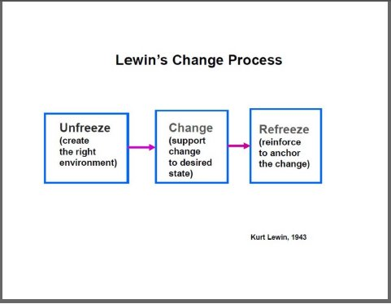

Slide 9
Practical Steps for Using the Framework:
1.UNFREEZE-
- Determine what needs to change.
- Ensure there is strong support from upper management.
- Create the need for change.
- Manage and understand the doubts and concerns.

Slide 10
Practical Steps for Using the Framework:
2.CHANGE-
- Communicate often.
- Dispel rumours.
- Empower action.
- Involve people in the process.

Slide 11
Practical Steps for Using the Framework:
3.FREEZE-
- Anchor the changes into the culture.
- Develop ways to sustain the change.
- Provide support and training.
- Celebrate success!!

Slide 12
For more MBA articles: www.mbaknol.com
THANK YOU

